Slide 2
Why a system for WiFi monitoring?
WiFi is among the most popular network access methods
Measuring the performance of the WiFi networks is challenging:
Air is a shared medium – other users and their usage patterns
Physical obstacles
Other networks
type of antenna, positioning, signal reflection, diffraction, refraction…
Measuring only signal strength or link quality from fixed points is not sufficient to get the impression about the Quality of user’s Experience (QoE)
Vendor solutions – closed and focused on the network equipment (APs)

Slide 3
What WiFiMon offers?
Vendor independent, open-source monitoring tool
Transparent to the users
Low network overhead (active monitoring tool)
Captures user’s perception of the network quality
Provides metrics like: throughput, latency, signal strength, link quality,…
The use of well-known open-source tools like: ELK, Akamai Boomerang, SpeedTest

Slide 4
WiFiMon – brief history
Idea from GN4-1 – how to capture the user’s perception of the WiFi network performance
Development in GN4-2 – crowdsourced WiFi monitoring
Uses well known tools:
Akamai Boomerang
Speedtest/libretest
Nettest
ELK stack
New features in GN4-3 – fixed hardware probes
The same tools as for the crowdsourced monitoring
Information about the signal strength and quality
Correlation with RADIUS logs
GEANT service since July 2020

Slide 5

WiFiMon building blocks and operation
Client – any user’s device
WHP – WiFiMon hardware probe (rPi)
WTS – WiFiMon Test Server - measurements
WAS – WiFiMon Analysis Server (ELK)
Site – popular web site (University, captive portal,…)
Some site
WAS
jS code
visit
results
WTS
tests
Client
WHP

Slide 6
WiFiMon - Data Flow
PERFORMANCE DATA
ANALYSE DATA
Real Time Analysis:
- Performance Data Parsing
Correlation of Performance Data with Accounting Data
Anonymized
HMAC SHA-512
(non) IEEE802.1X / eduroam enabled infrastructures:
- End-users: smartphones, laptops - Hardware Probes: RPi
Filtered RADIUS
Logs
Correlation Results
ACCOUNTING DATA
STORE DATA
CONSUME & VISUALIZE DATA
Anonymized
HMAC SHA-512
DHCP and RADIUS Logs:
- Data Filtering (Logstash)
Data Storage (Elasticsearch) - Filtered RADIUS Logs - Correlated Results (persistent data): Performance Data correlated with RADIUS logs
WiFiMon GUI:
- Visualisation (Kibana) for network administrator
- User Options
6

Slide 7
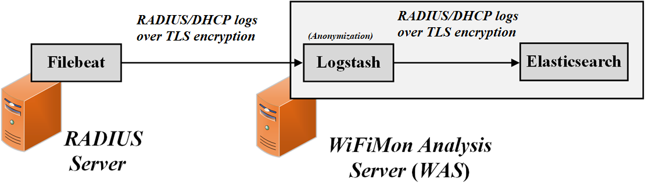
Feedback Integration – RADIUS Logs Privacy
Filebeat: RADIUS logs are streamed encrypted (TLS) to the WiFiMon Agent. Only fields of interest are streamed to reduce total size.
Logstash: RADIUS logs information is obfuscated by Logstash using the HMAC algorithm. Thus the data is directly compared and stored anonymized in Elasticsearch.

Slide 8
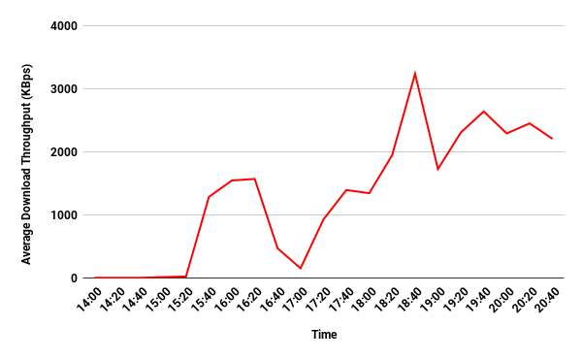

How to read the results?
TCP throughput is not a real achievable throughput
Look at the relative changes
Baseline – when the network is quiet
WHP – changes of the WiFi network parameters
Crowdsourced – changes of the perceived quality metrics

Slide 9
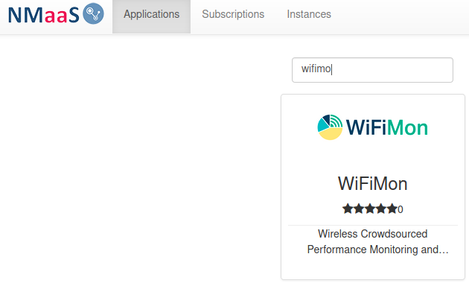
WiFiMon service model
Download and install, support from WiFiMon team
Interested institutions install all the components at their premises (no GDPR issues)
If needed (for testing/trying) WiFiMon team offers a central WiFiMon WAS instance per institution on NMaaS (operated by WP6T3)
If you are interested, register at (our mailing lists): https://www.geant.org/wifimon/Pages/Register.aspx

Slide 10
Come to our Infoshare!
Infoshare on November 5th. Much more technical details, installation guides, results...
Register at: https://events.geant.org/event/221/
Other resources:
GEANT WiFiMon page: https://www.geant.org/wifimon/Pages/default.aspx
WiFiMon wiki page: https://wiki.geant.org/display/WIF
WiFiMon code: https://bitbucket.software.geant.org/projects/WFMON/repos/agent/browse
Publications and Presentations: https://wiki.geant.org/display/WIF/WiFiMon+Publications

